Slide 1
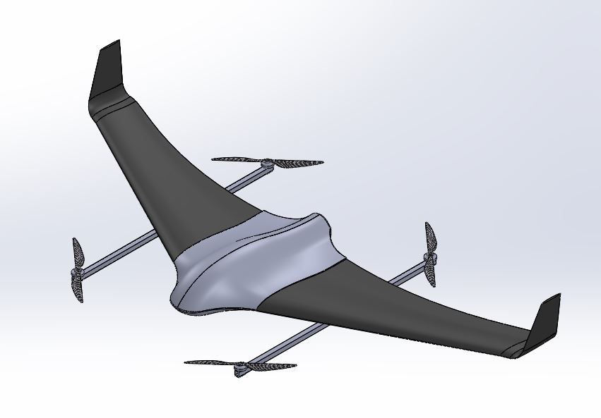
ME FYP Progress Report
04/10/2021
Cheung Hiu Ching, Athena
Fung Ka Chun, Tim
Liu Sum Yin, Kylie

Slide 2
TABLE OF CONTENTS
01
03
Introduction
Current progress
02
04
Planning/Schedule
Future Works
Introduce the missions of our VTOL UAV
Gantt chart from Aug to Oct 2021

Slide 3
01
Introduction
Introduce the missions or requirements of our VTOL UAV

Slide 4
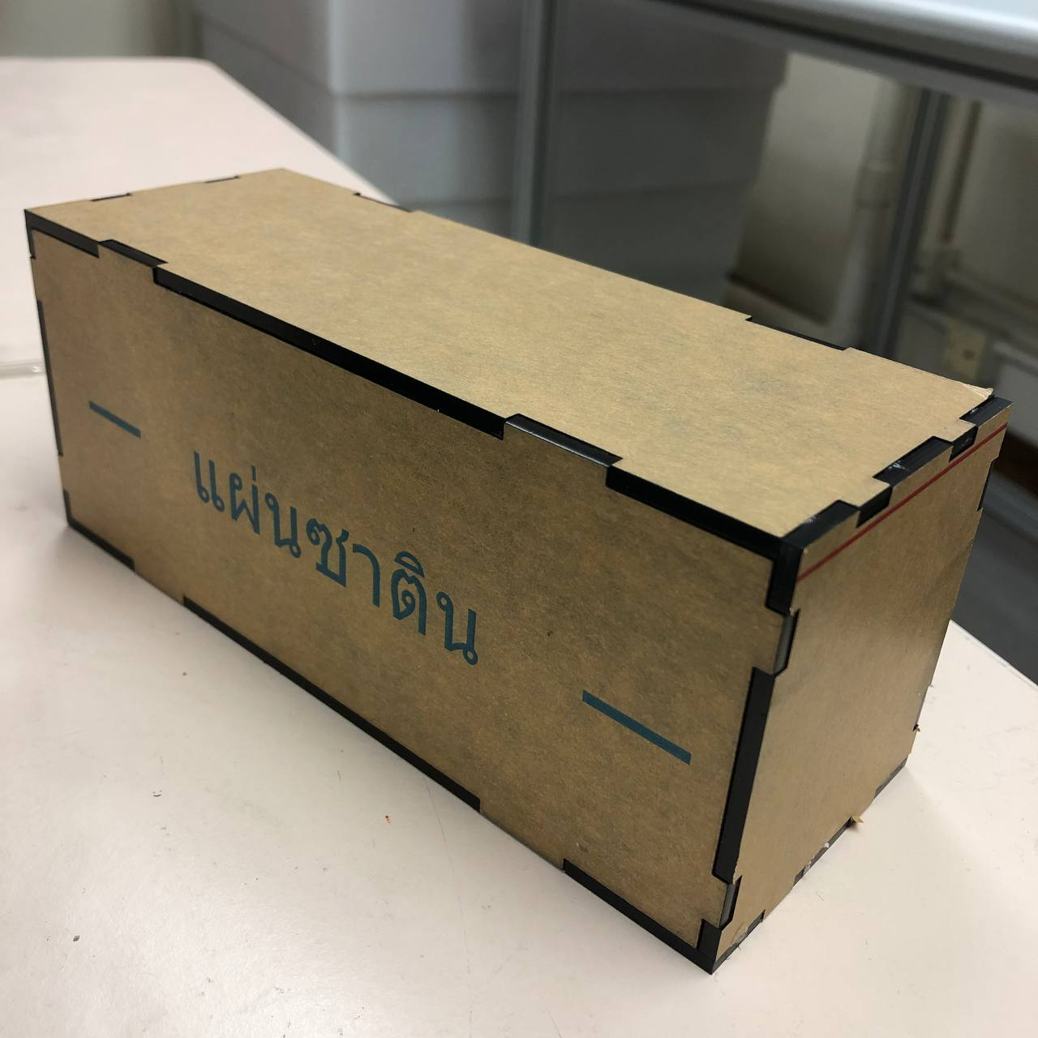
Introduction: Missions/requirements of our VTOL UAV
Payload:
Dimensions: around 191*79*71 (mm) (exclude antenna)
Weight: around 1 kg
Layout: combination of fixed wing and rotors
Type of power supply: electric brushless motor
Major material: wood & carbon fiber

Slide 5
Introduction: Missions/requirements of our VTOL UAV
Referring to “v11.PSTS (revised prototypes and samples quantity).pdf” P.3, 8-9:
Air speed: 15 to 20 m/s
Flight altitude: 100 to 500 m
Flight duration: > 30 min (aim: around 1 hour)
Flight range: > 30 km

Slide 6
Planning/Schedule
02
Gantt chart from Aug to Oct 2021

Slide 7
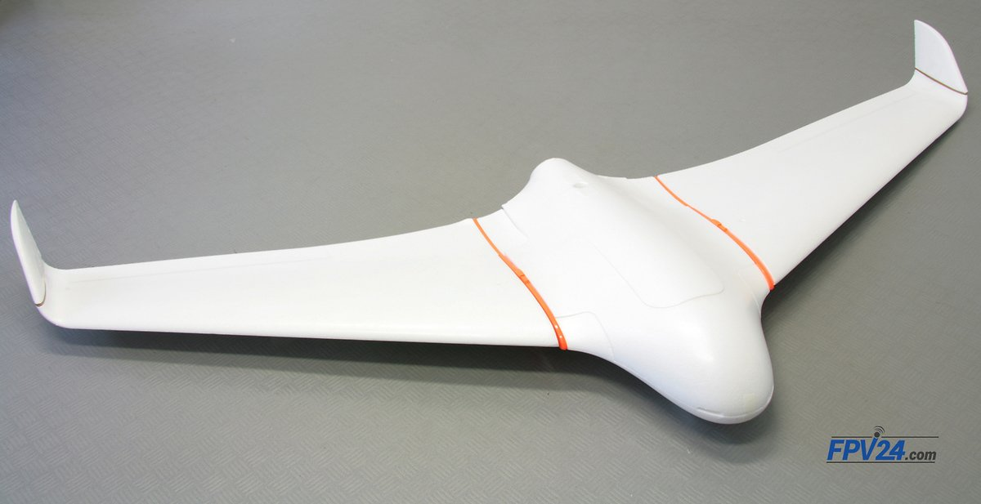
Stages of VTOL UAV Study:
Select reference UAV
Skywalker X8
Select component
Calculation of the motors and learn basic electronics
Build Skywalker X8
Fly Skywalker X8
Prove its performance and collect relative data

Slide 8
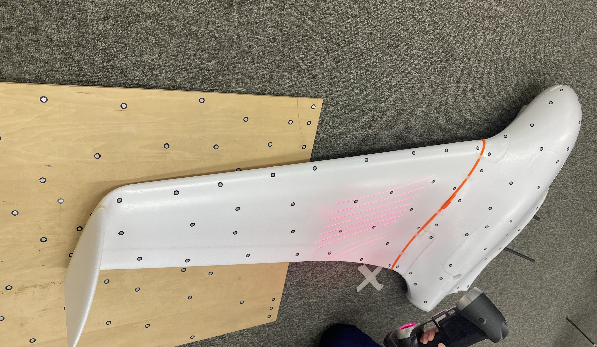
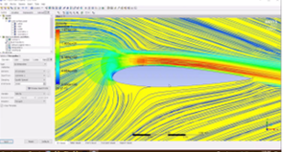
Stages of VTOL UAV Study:
Design CF VTOL UAV
3D scanning & 3D CAD drawing
CF VTOL UAV Simulation + Calculation
Solidworks/ANSYS
Confirm final design and fabricate using molding
Fly CF VTOL UAV
Test performance, compare the results with the theory

Slide 9
Gantt chart: from Aug to Dec 2021
 | Aug W1-2 | Aug W3-4 | Sep W1-2 | Sep W3-4 | Oct W1-2 | Oct W3-4 | Nov W1-2 | Nov W3-4 | Dec W1-2 | Dec W3-4
Self-Learning
Build VTOL X8
Draw CAD (CF mold)
Do simulation & calculation
Make CF VTOL
Write interim report
Midterm & Exam
1 Aug - 22 Aug
23 Aug - 16 Oct
1 Sep - 23 Oct
22 Aug - 30 Oct
17 Oct - 31 Dec
1 Sep – 22 Nov
2 Dec - 17 Dec

Slide 10
Current progress
03
Present our own ideas & preparation

Slide 11
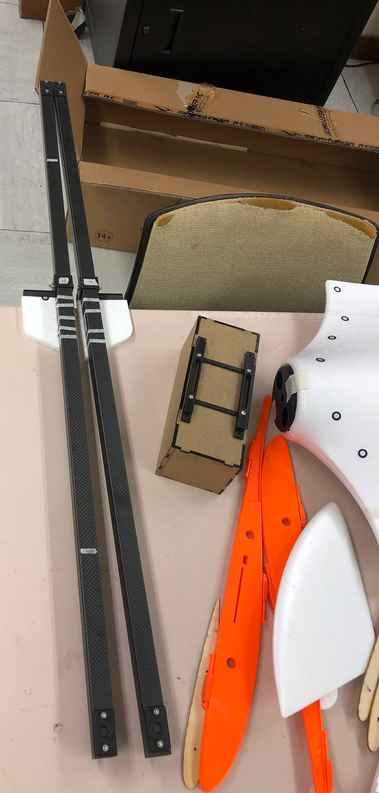
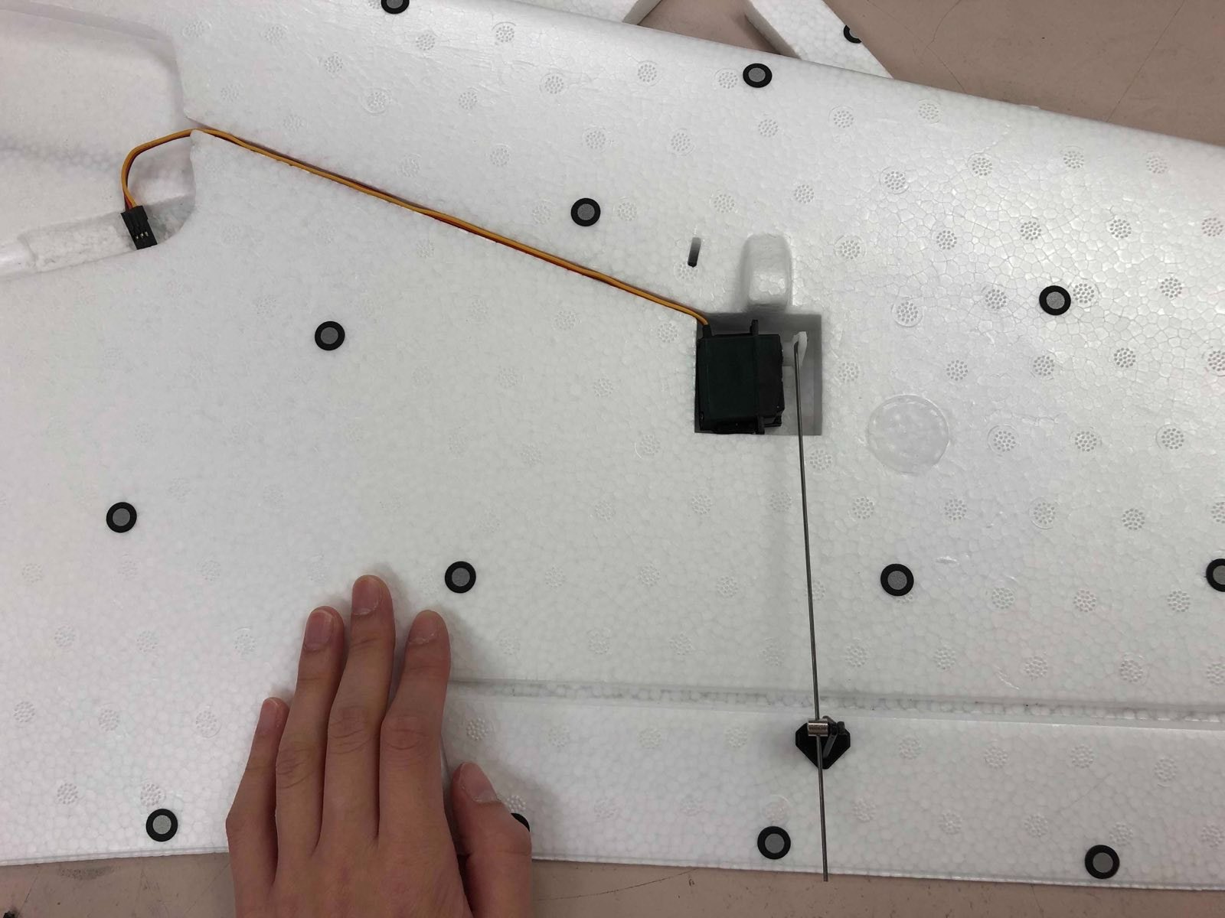
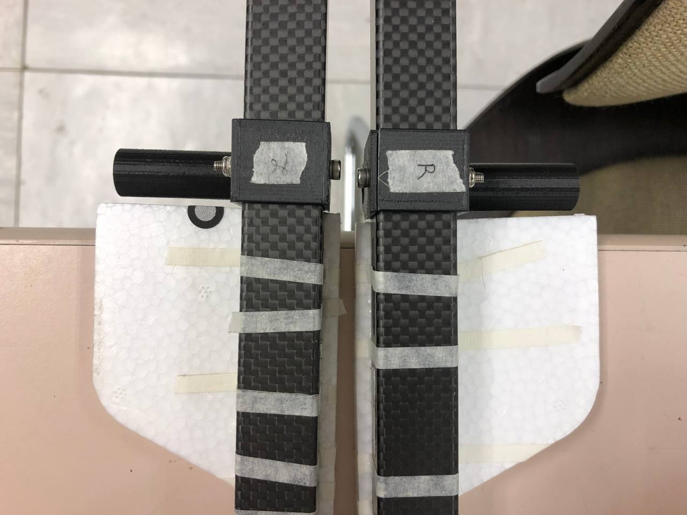
Current progress
Bought & building Skywalker X8

Slide 12
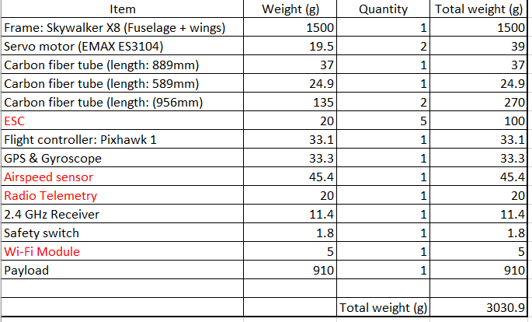
Current progress
Calculation for the selections of VTOL motors & Pusher motor

Slide 13
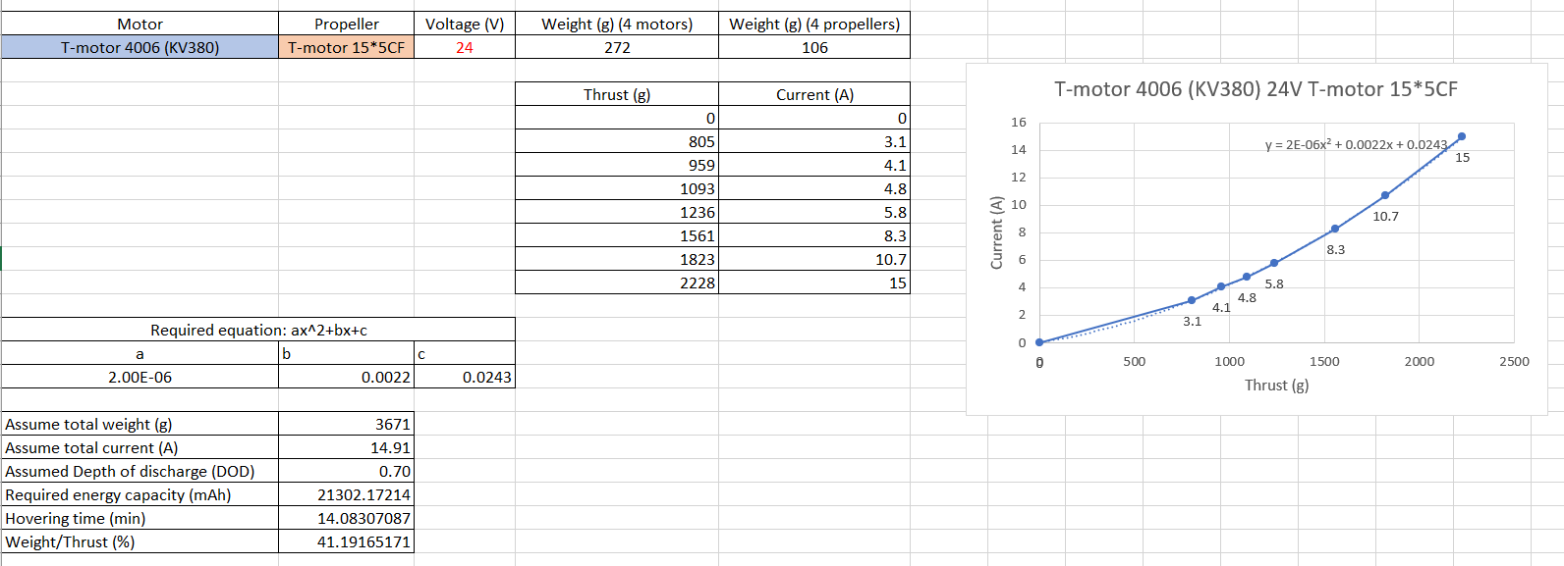
Current progress
Calculation for the selections of VTOL motors

Slide 14
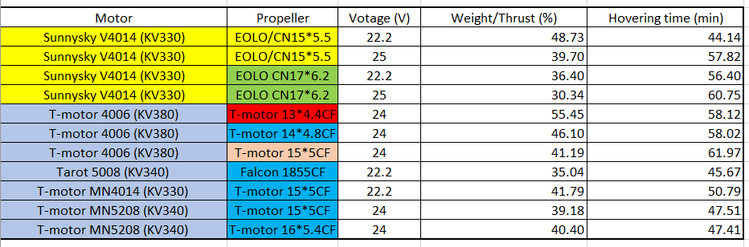
Current progress
Calculation for the selections of VTOL motors
Highest

Slide 15
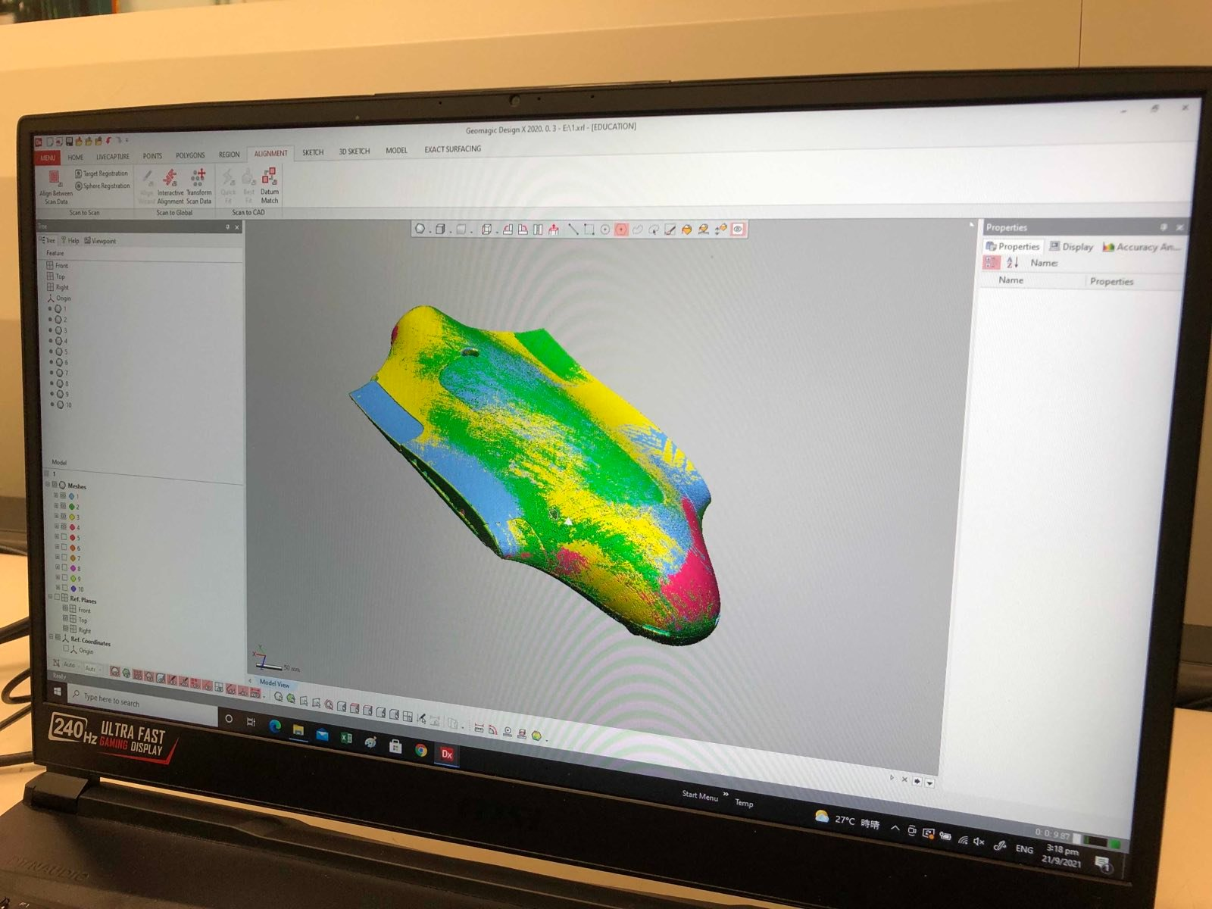
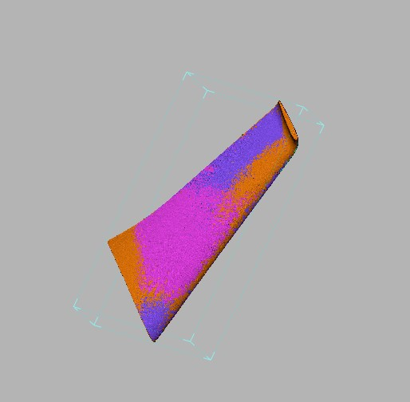
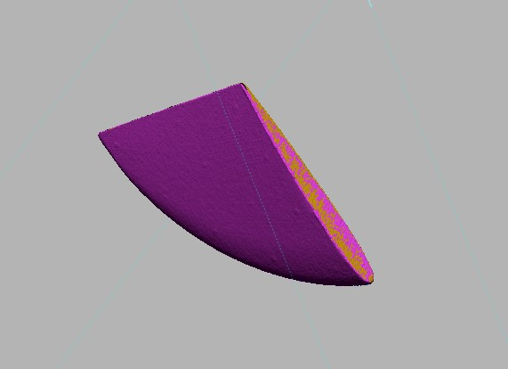
Current progress
3D scanning of fuselage & wings for making CF mold

Slide 16
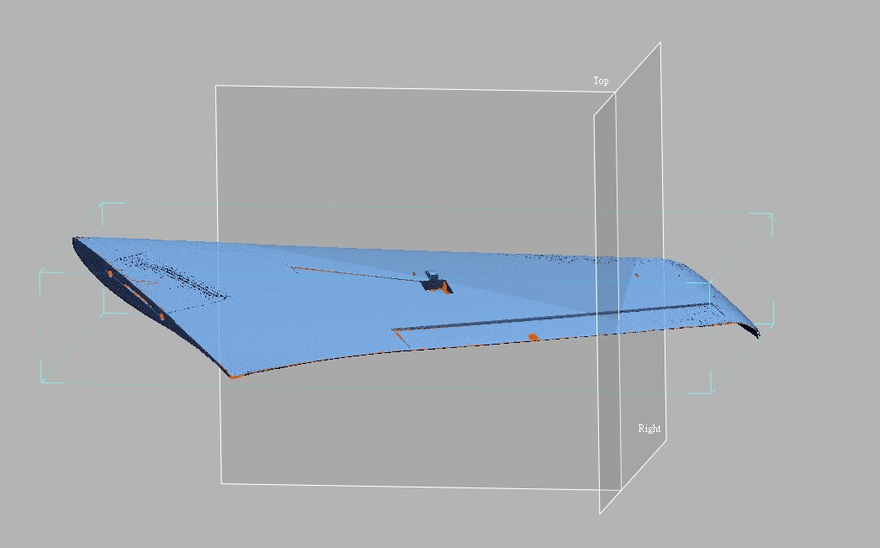
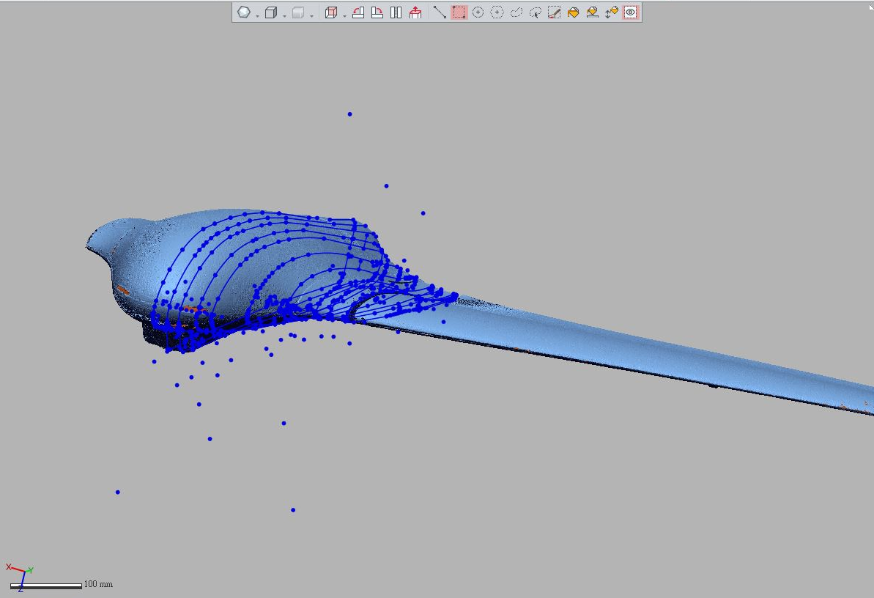
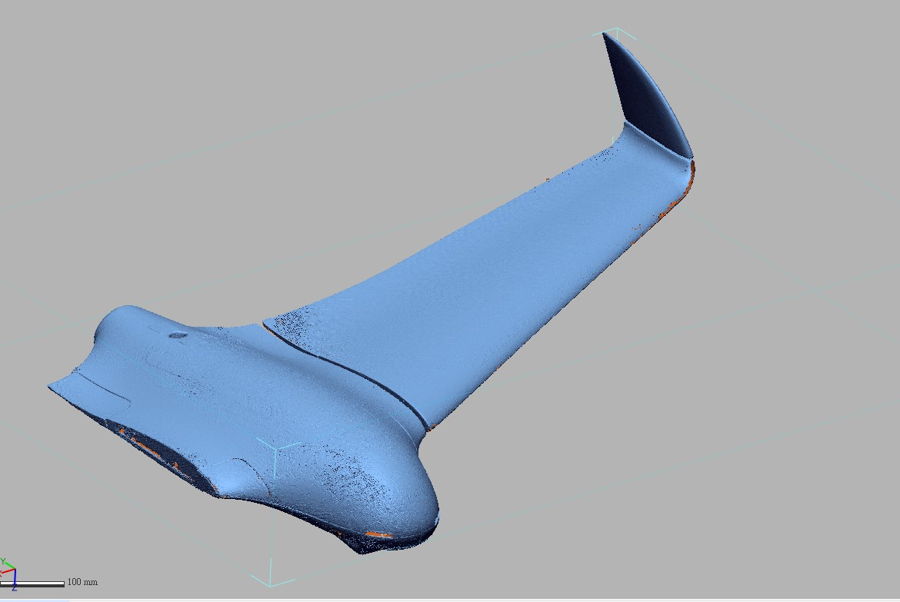
Current progress
3D scanning of fuselage & wings for making CF mold

Slide 17
Future Works
04

Slide 18
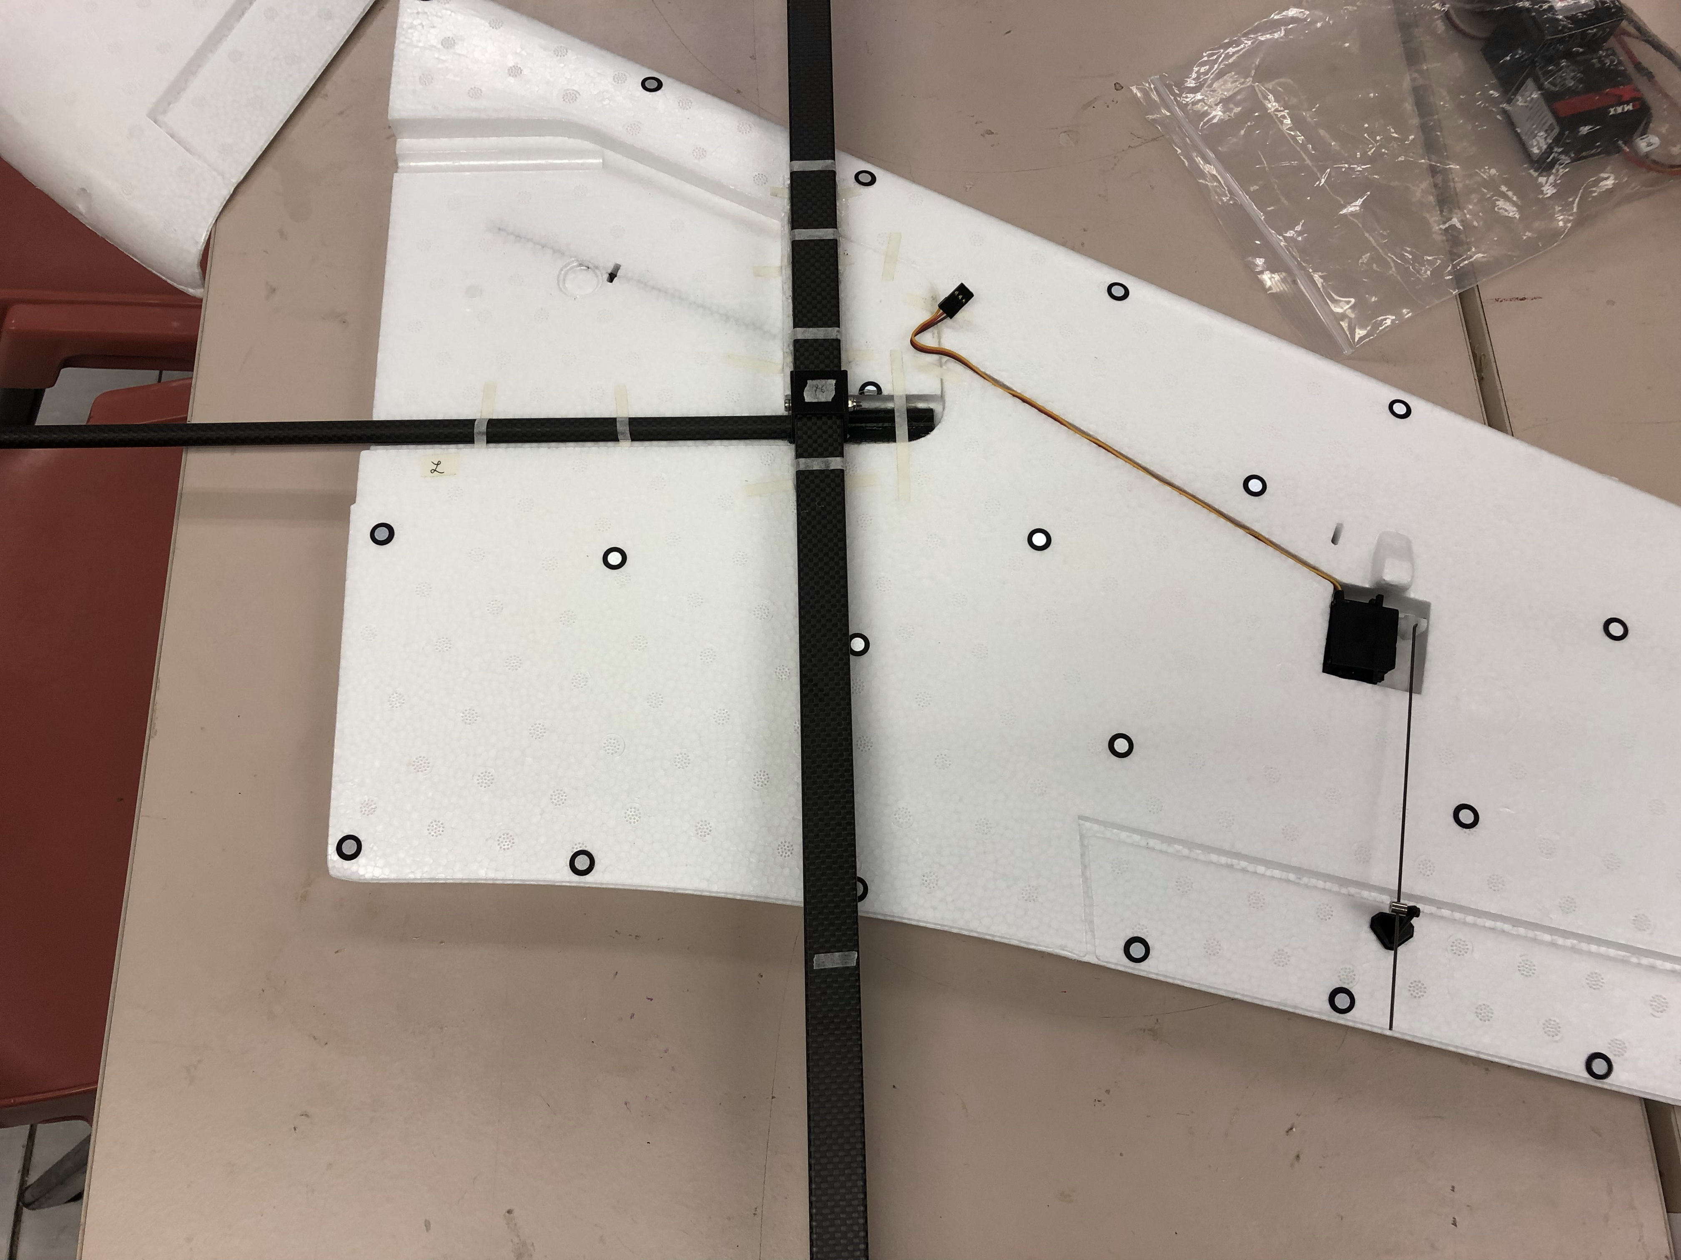
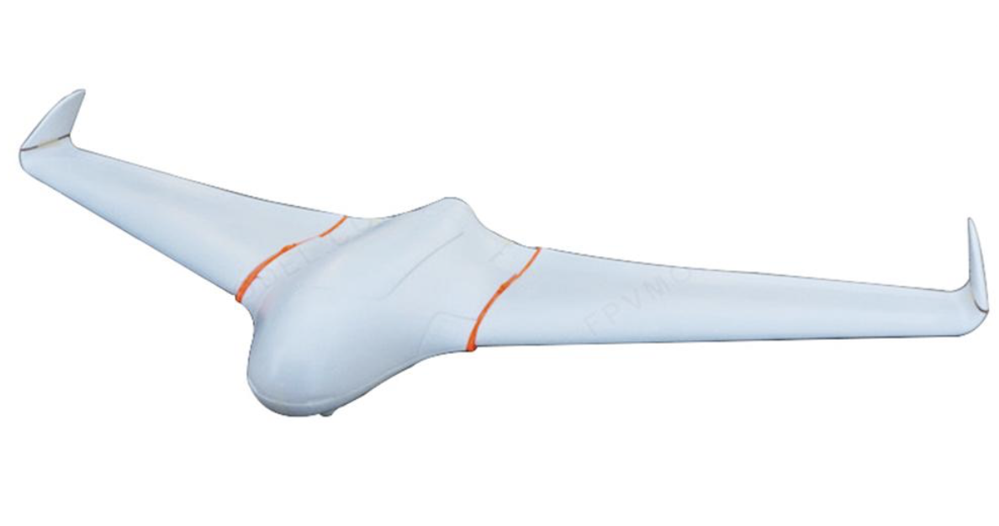
Future Works (by next monthly meeting)
Build & Fly Skywalker X8

Slide 19
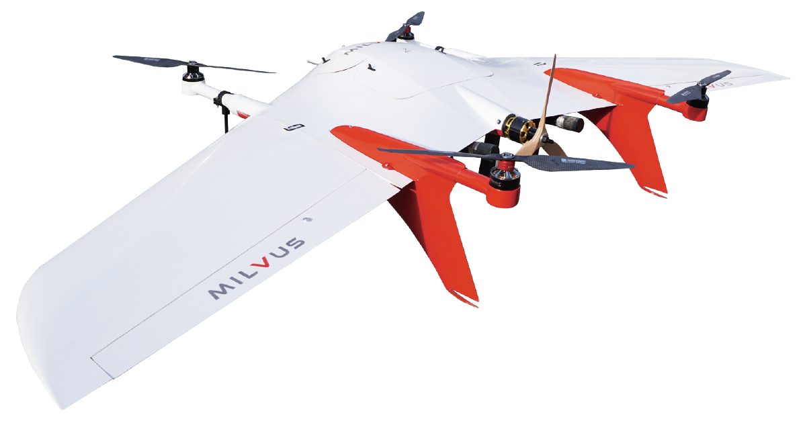
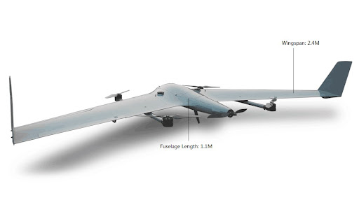
Future Works (by next monthly meeting)
Select wings for CF VTOL UAV

Slide 20
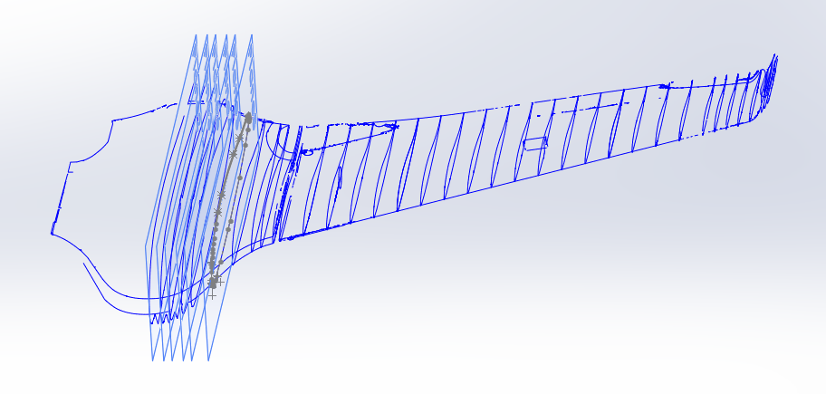
Future Works (by next monthly meeting)
Draw CF mold of fuselage in SolidWorks
Draw CF mold of wings in SolidWorks (if possible)

Slide 21
Thank You

